Slide 1

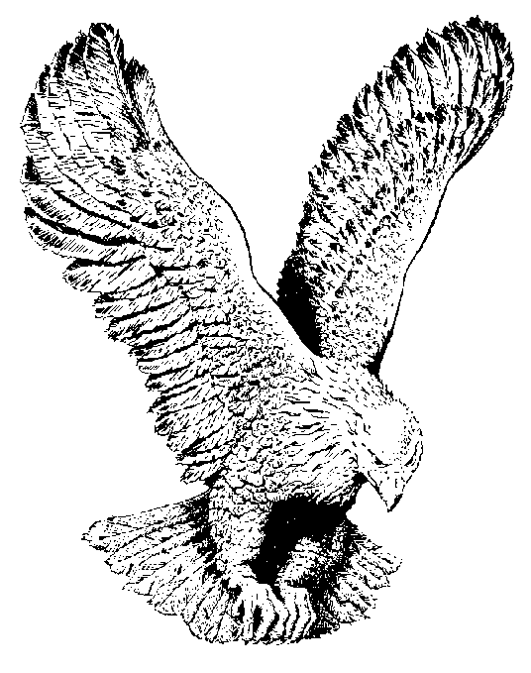
630 I DELIGHT TO DO THY WILL
I delight to do thy will O Lord
I delight to do thy will
And to walk with thee
Is not grievous unto me
For I delight to do thy will.

